Slide 1
Data Structure and Algorithm CSE-225
Dr. Mohammad Abu Yousuf
yousuf@juniv.edu

Slide 2
Some Sorting Algorithm

Slide 3
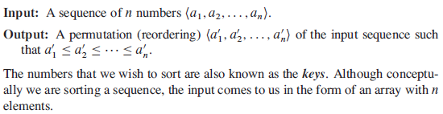
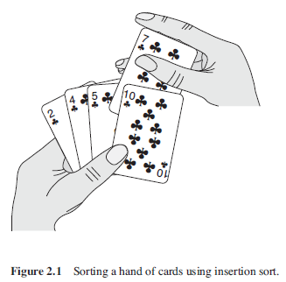
Insertion sort (1)

Slide 4
Insertion sort (2)
Pseudocode for insertion sort as a procedure called INSERTIONSORT, which takes as a parameter an array A[1…n] containing a sequence of length n that is to be sorted. (In the code, the number n of elements in A is denoted by A.length.)
The algorithm sorts the input numbers in place: it rearranges the numbers within the array A, with at most a constant number of them stored outside the array at any time.
The input array A contains the sorted output sequence when the INSERTION-SORT procedure is finished.

Slide 5
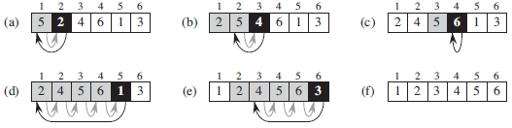
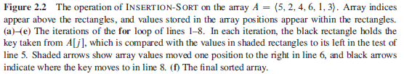
Insertion sort (3)

Slide 6
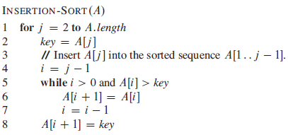
Insertion sort (4)

Slide 7
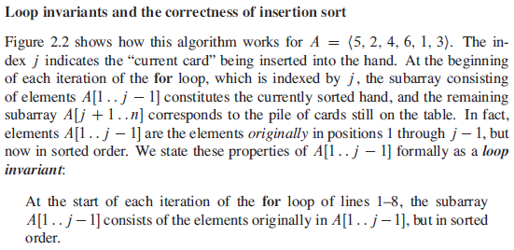
Insertion sort (5)

Slide 8
Analyzing algorithms(1)
Analysis of insertion sort:
The time taken by the INSERTION-SORT procedure depends on the input: sorting a thousand numbers takes longer than sorting three numbers.
Moreover, INSERTIONSORT can take different amounts of time to sort two input sequences of the same size depending on how nearly sorted they already are.
In general, the time taken by an algorithm grows with the size of the input, so it is traditional to describe the running time of a program as a function of the size of its input.
To do so, we need to define the terms “running time” and “size of input” more carefully.

Slide 9
Analyzing algorithms(2)
The best notion for input size depends on the problem being studied. For many problems, such as sorting or computing discrete Fourier transforms, the most natural measure is the number of items in the input—for example, the array size n for sorting.
For many other problems, such as multiplying two integers, the best measure of input size is the total number of bits needed to represent the input in ordinary binary notation.
Sometimes, it is more appropriate to describe the size of the input with two numbers rather than one. For instance, if the input to an algorithm is a graph, the input size can be described by the numbers of vertices and edges in the graph.

Slide 10
Analyzing algorithms(3)
The running time of an algorithm on a particular input is the number of primitive operations or “steps” executed.
It is convenient to define the notion of step so that it is as machine-independent as possible. For the moment, let us adopt the following view. A constant amount of time is required to execute each line of our pseudocode.
One line may take a different amount of time than another line, but we shall assume that each execution of the ith line takes time c_{i}, where c_{i} is a constant.

Slide 11
Analyzing algorithms(4)
We start by presenting the INSERTION-SORT procedure with the time “cost” of each statement and the number of times each statement is executed.
For each j = 2,3,……,n, where n = A.length, we let t_{j} denote the number of times the while loop test in line 5 is executed for that value of j. When a for or while loop exits in the usual way (i.e., due to the test in the loop header), the test is executed one time more than the loop body.
We assume that comments are not executable statements, and so they take no time.

Slide 12
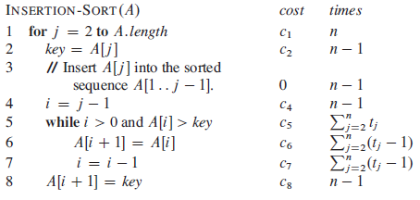
Analyzing algorithms(5)

Slide 13
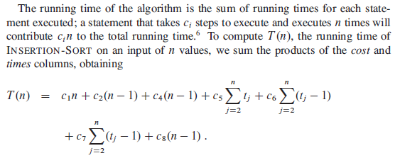
Analyzing algorithms(6)

Slide 14
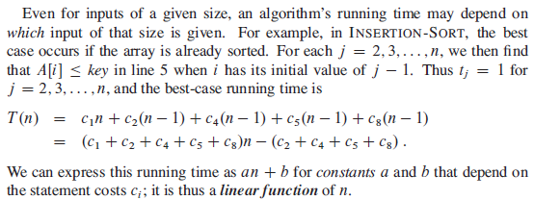
Analyzing algorithms(7)

Slide 15

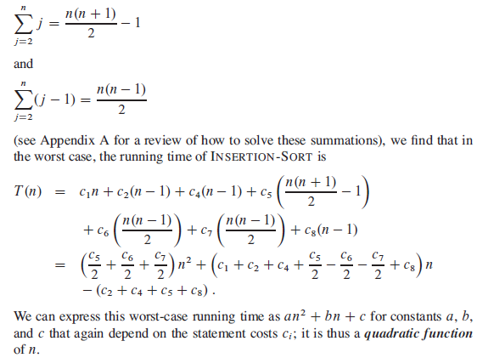

Slide 16
Order of growth
We used some simplifying abstractions to ease our analysis of the INSERTIONSORT procedure.
First, we ignored the actual cost of each statement, using the constants c_{i} to represent these costs.
Then, we observed that even these constants give us more detail than we really need: we expressed the worst-case running time as an² + bn + c for some constants a, b, and c that depend on the statement costs c_{i} . We thus ignored not only the actual statement costs, but also the abstract costs c_{i} .
We shall now make one more simplifying abstraction: it is the rate of growth, or order of growth, of the running time that really interests us.
We therefore consider only the leading term of a formula (e.g., an²), since the lower-order terms are relatively insignificant for large values of n.

Slide 17
Divide and Conquer algorithms

Slide 18
For insertion sort, we used an incremental approach: having sorted the sub-array A[1…. j -1], we inserted the single element A[j] into its proper place, yielding the sorted sub-array A[1……j] .
we examine an alternative design approach, known as “divide and conquer,”. We’ll use divide and conquer to design a sorting algorithm whose worst-case running time is much less than that of insertion sort.

Slide 19
The divide-and-conquer approach
The divide-and-conquer paradigm involves three steps at each level of the recursion:
Divide the problem into a number of sub problems that are smaller instances of the same problem.
Conquer the sub problems by solving them recursively. If the sub problem sizes are small enough, however, just solve the sub problems in a straightforward manner.
Combine the solutions to the sub problems into the solution for the original problem.

Slide 20
The merge sort algorithm closely follows the divide-and-conquer paradigm. Intuitively, it operates as follows.
Divide: Divide the n-element sequence to be sorted into two subsequences of n=2 elements each.
Conquer: Sort the two subsequences recursively using merge sort.
Combine: Merge the two sorted subsequences to produce the sorted answer

Slide 21
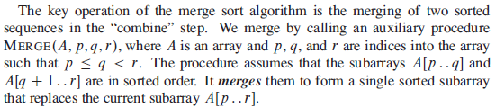

Slide 22
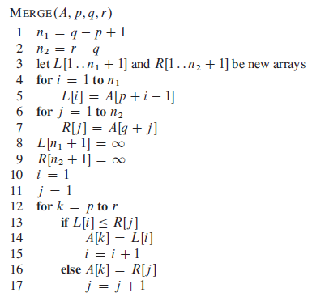

Slide 23
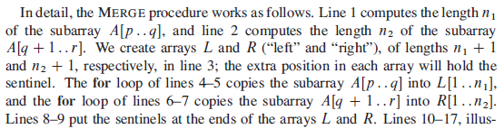


Slide 24
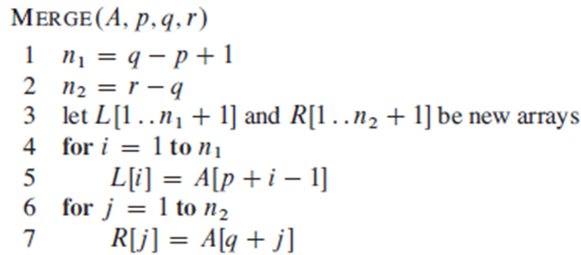
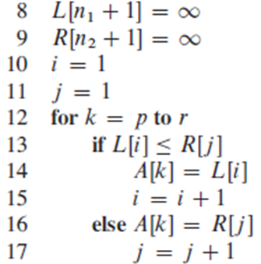
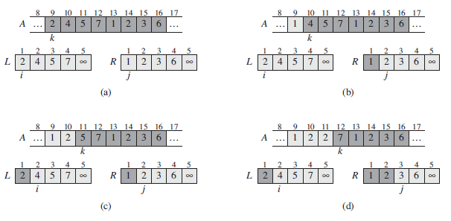

Slide 25
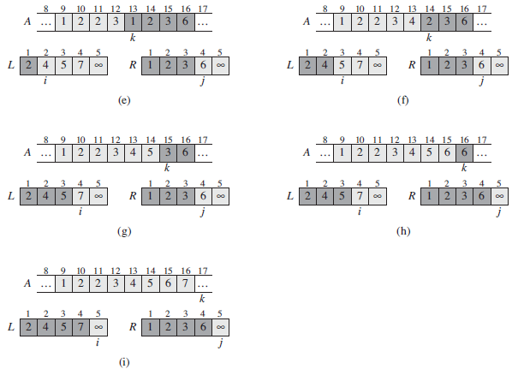

Slide 26
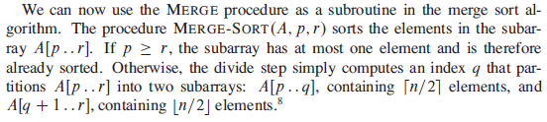
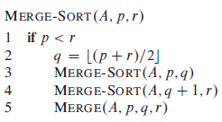
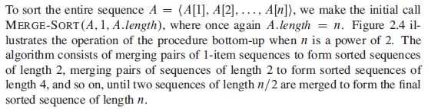

Slide 27
